Slide 1
Movie Ticket Booking System
PREPARED BY:- Aman Vyas

Slide 2
Introduction
This project is aimed at developing an movie ticket booking system for customers. This project saves lots of time as booking the movie ticket can be done from anywhere and at any time(24*7). some features provided to the users are new registration, login, see movies by category, timing, customer can book ticket without registration but if he/she registers then he/she will get different types of special offers, e-newsletters, movie updates and lots more through E-mail. The user can also cancel or update their order as well.

Slide 3
Research and analysis
Attraction of People towards online shopping and e-commerce has open new vistas and exciting opportunity in India. Online Movie Ticket Booking Systems is mainly eyeing on middle class for whom this is cheapest source of entertainment. This System provide the cheapest online movie-ticket booking taxes and also give much more offers than the other booking system for their users (but only for the registered users).

Slide 4
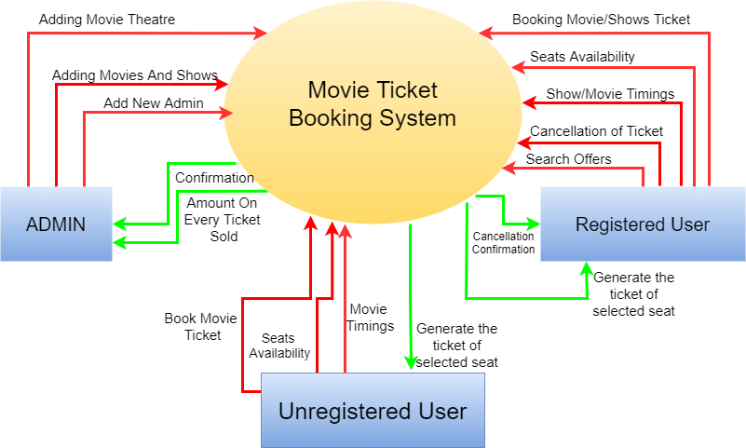
0th level dfd (Data flow diagram)

Slide 5
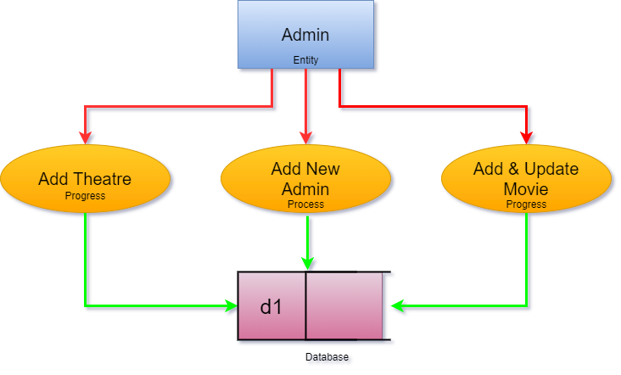
Categorization or 1st level dfd

Slide 6
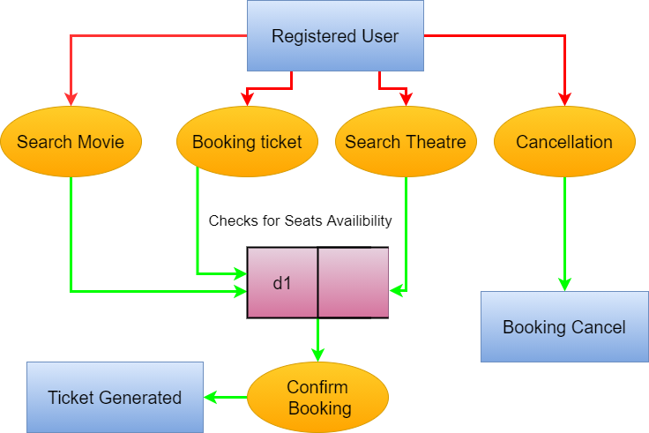
Categorization or 1st level dfd

Slide 7
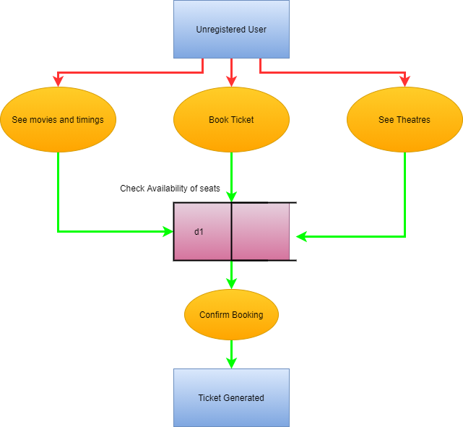
Categorization or 1st level dfd

Slide 8
Categorization of project
This Project is divided into three main different modules which are as:-
Admin.py
regesteredUser.py
unregisteredUser.py

Slide 9
Admin module
This module deals with the insertion and updating of theaters and movies. The admin will be the one who is owning or having his own Cineplex or Multiplex. Every Movie has a fixed time period of staying at any Cineplex or Multiplex. That’s why, it is the duty of admin to update the movie for his theatre.
If the admin is not updating the shows for a month then his theatre is considered to be closed and users can’t book movies and shows for the same.

Slide 10
Unregistered user module
This module comes in act when there is a user trying to book a movie or searching its details, but without logging in. In this case that user is considered as an unregistered user. The user can book the tickets for any movie and will be showed up with the details about the movies and theaters. But there are some benefits and offers which these users are going to miss (like:- discount on tickets, Buy 2 get 1 offer, gift cards etc. ) which are only available for Registered Users only.

Slide 11
Registered user module
This module comes in act when there is a user trying to book a movie or searching its details, but after login himself on this system. By login or registering he is going to get some of the offers which are follows as:-
Get 15% discount on tickets on booking for the third time on this system.
Buy two Get one ticket free on Sundays.
Send Gift Cards to another Person.
Get additional 10% discount on tickets on booking food and beverages also.
Visa Cards , Credit Cards, and online wallet offers.

Slide 12
Database and storage
This project consist of two technologies for storing some data:-
1. MySQL 2. JSON
Here MySQL is used for storing strong data or Records (like:- User Data, Movie Details, Theatre Details.)
JSON is used here for storing some temporary or common data (like:- cities names only, seats availability etc)

Slide 13


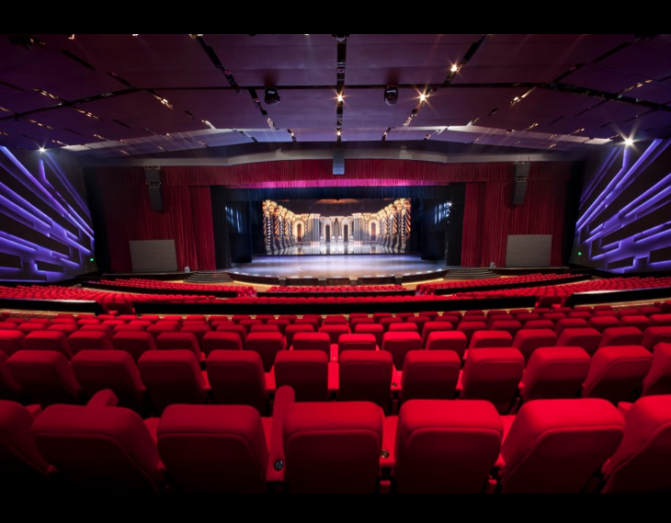
Database design
The Database is designed as minimal as possible. In this project, the database contains 3 different Relations (or Tables) for storing data which are as follows:-
1. User Data 2. Movies Data 3. Theatres Data

Slide 14
User data
It consists of user details and have following attributes:-
uid (user id) (as PRIMARY KEY)
user_email (email address of the user ) (as UNIQUE KEY)
user_pass (password)
user_name (user’s name)
user_contact (user contact number)
user_role (Admin or user)

Slide 15
Movies data
It consists of Movies details which are currently running in any theatre and contains following attributes:-
Mov_id (movies id) (as PRIMARY KEY)
Mov_name (name of the movie)
Theatre (theatre id as FORIGN KEY)

Slide 16
theatre
This Relation deals with the details of the theatre which an admin owns. There are several attributes:-
Thid (theatre id) (as PRIMARY KEY)
Th_name (theatre name)
Th_address (address of the theatre)
Th_city (city in which it is located)
Th_state (state of the city)

Slide 17
Hardware and Software Required
Hardware:-
CPU – Any Dual Core Processor
RAM – 512 Mb
Storage –
OS – Windows XP/vista/7/8/10
Software:-
Python 3.5 or higher
MySQL Server
Pymysql Module

Slide 18
References
https://pythonbasics.org/tkinter-image
https:\\www.kaggle.com
https://www.activestate.com/resources/quick-reads/how-to-add-images-in-tkinter/

